Slide 1
Hr Analysis case study
Sicheng Yang
DSI
Oct 20
github.com/kkarzyang/Presentation

Slide 2
Intro
- Predict promotion or not
- Sociology research, junior employees, current students
- Classification problem
- Kaggle
- Collected from HR datasets (by shivan kumar)

Slide 3
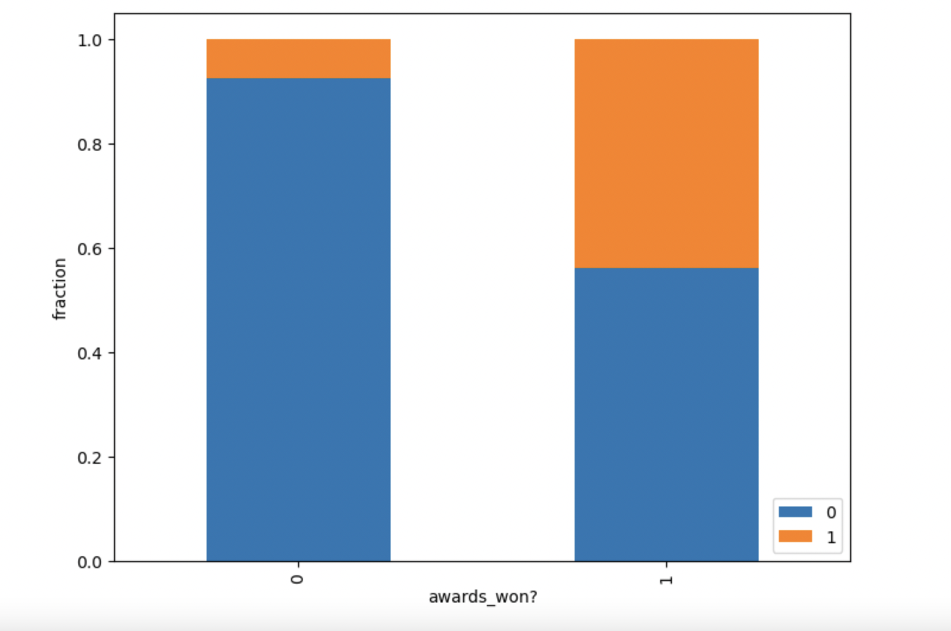
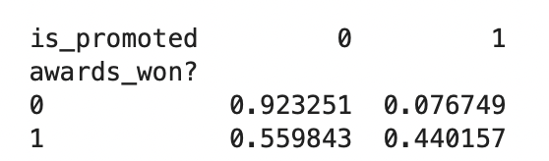
EDa
IDs get dropped
Features: 12
Target Variable: is_promoted
Why?

Slide 4
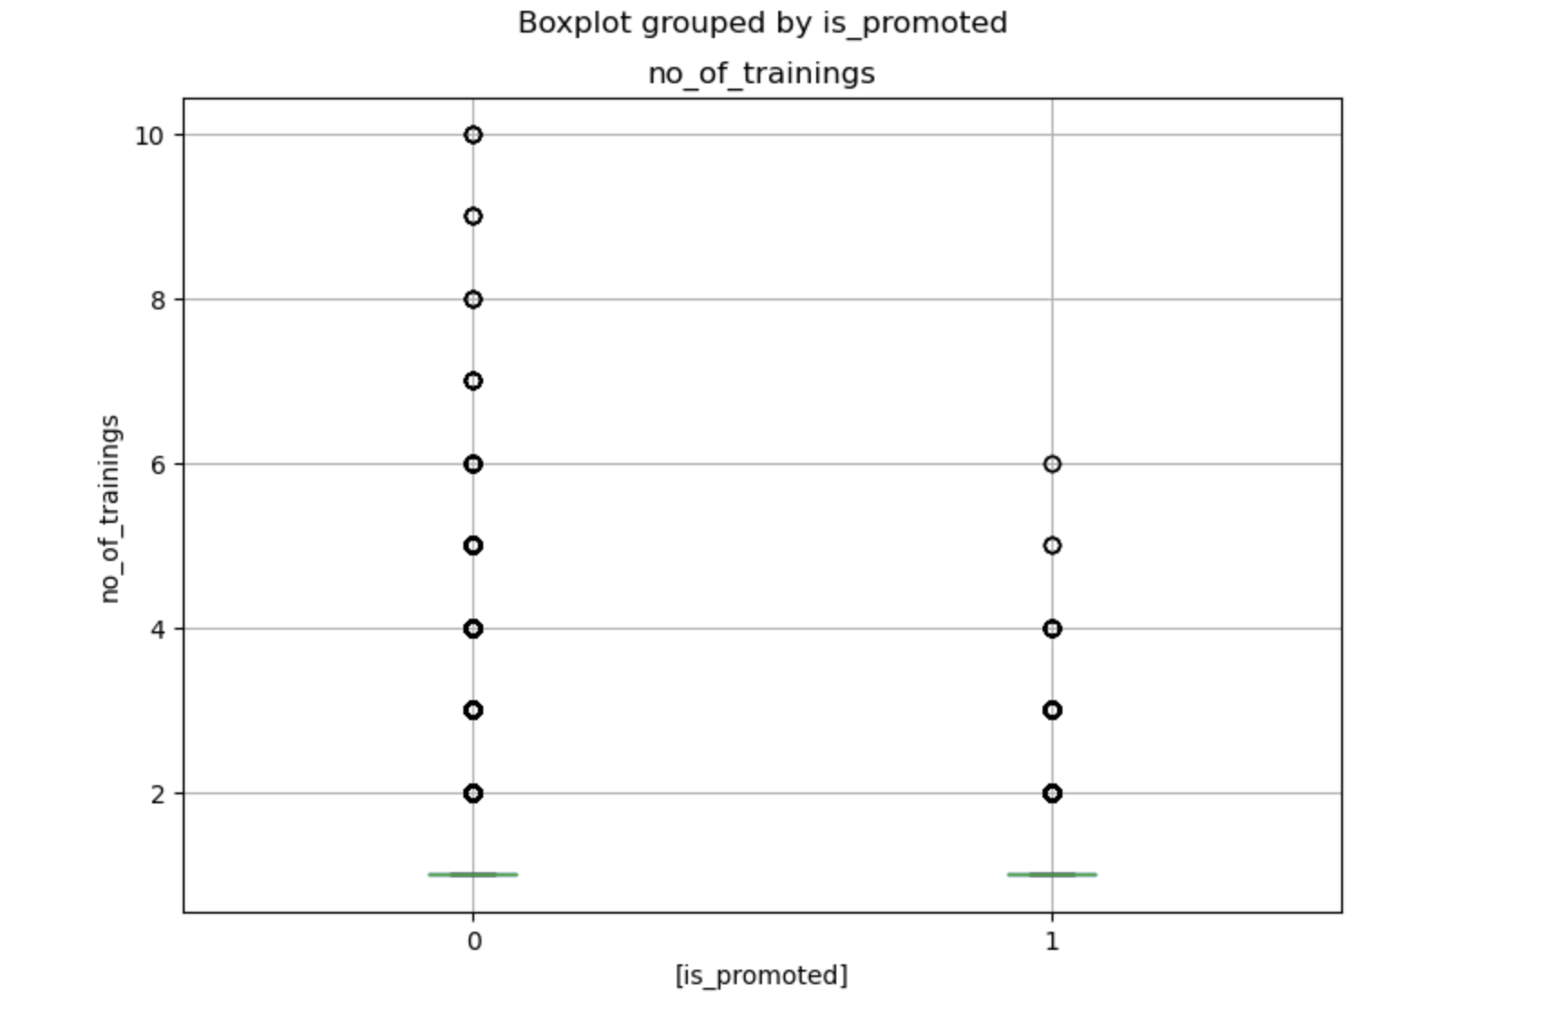
EDa
Why?

Slide 5
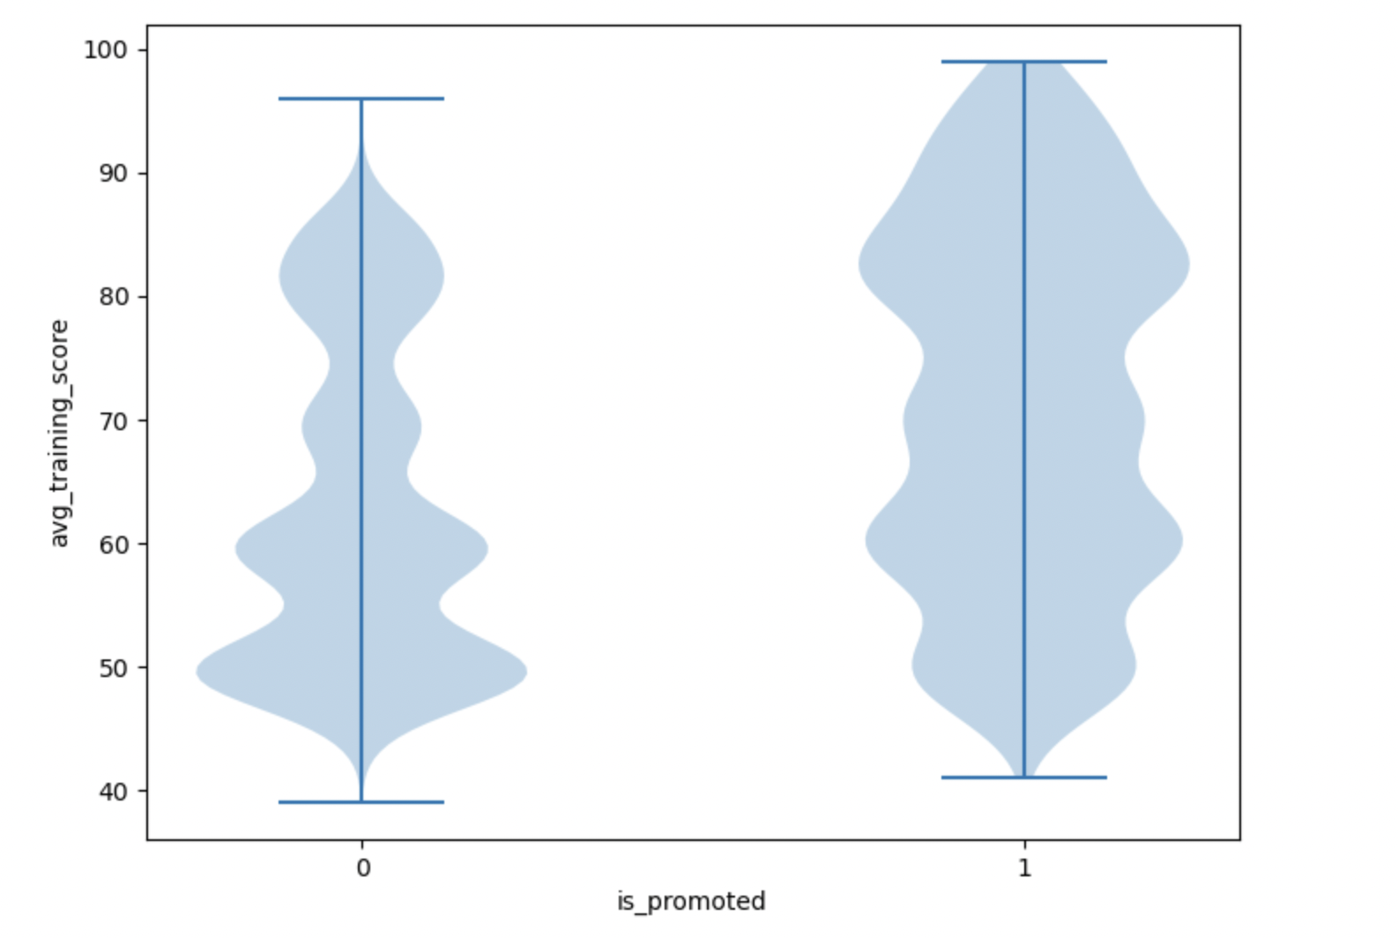
EDa
Why?

Slide 6
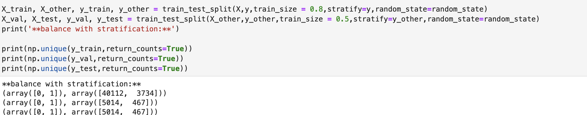
splitting
HOW & WHY

Slide 7
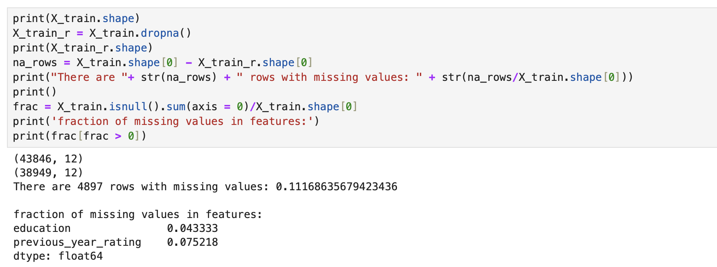
PREPROCESSING
Missing values

Slide 8
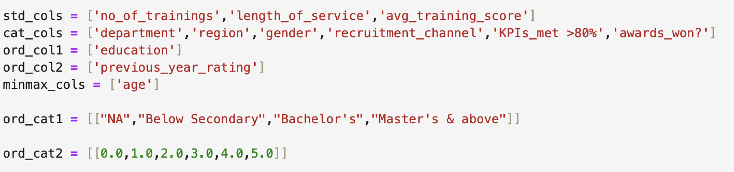
PREPROCESSING
WHAT & WHY

Slide 9
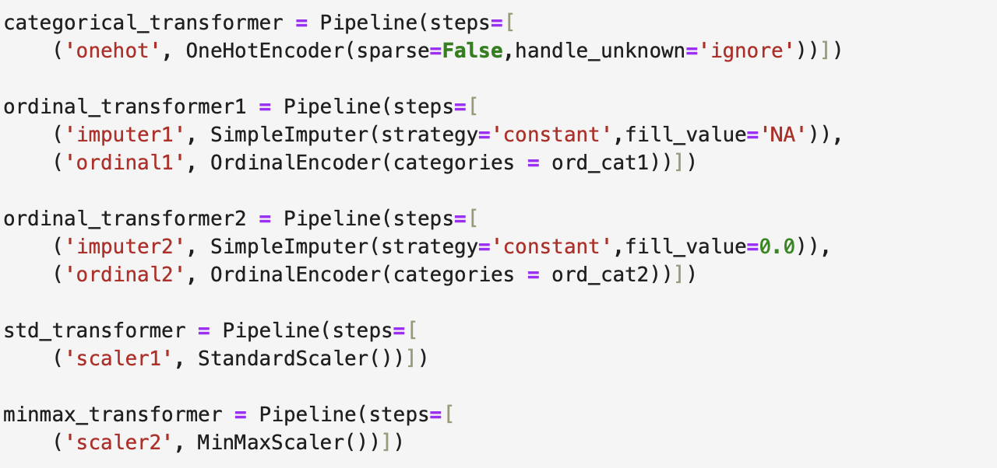
PREPROCESSING
WHAT & WHY

Slide 10
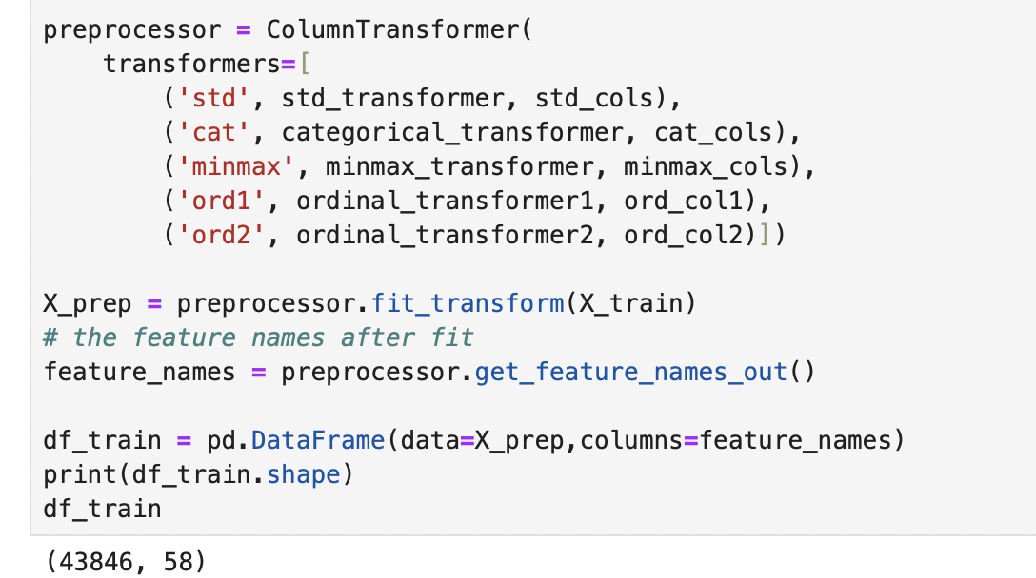
PREPROCESSING
WHAT & WHY (Apply transform on val/test datasets)

Slide 11
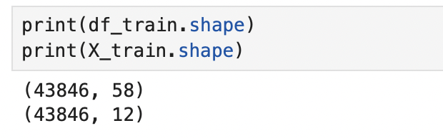
PREPROCESSING
BEFORE & AFTER

